Slide 1
Java Class
Day 10

Slide 2





Jul
Aug
TOEIC(7/24) 6/6~7/11
TEPS(7/16) 6/29~7/12
TOEIC(8/07) 6/20~7/25
TOEIC(8/21) 7/ 4 ~ 8/ 8
TEPS (8/06) 6/20~7/17
TEPS (8/20) 7/ 4 ~7/31
Big Data Analyst(10/1)
8/29~9/2
ADsP(8.28) 8/1~8/5
www.toeic.co.kr
www.teps.or.kr
www.dataq.or.kr
austin.sogang.ac.kr
austiny.snu.ac.kr

Slide 3
Mon
Tue
Wed
Thu
1. Main
Fri
1. Recap Sub
2. Main
2.
3. Main
3.
4. Main
4.
LUNCH
LUNCH
5. Sub
5. Recap Main
6. Sub
6.
7. Sub
7.
8. Recap, Test
8. Test
Jul
Aug
Java Basic
HTML, CSS, JS
Java Intermediate
Database

Slide 4
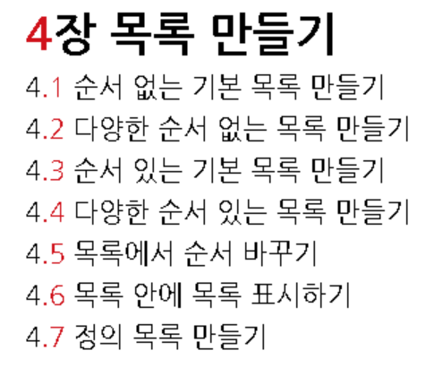
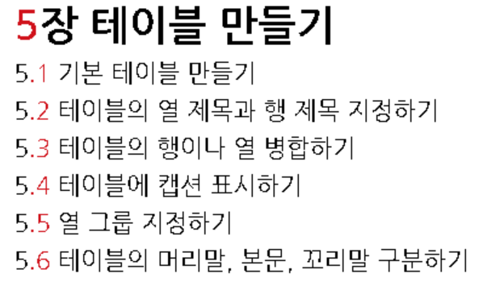
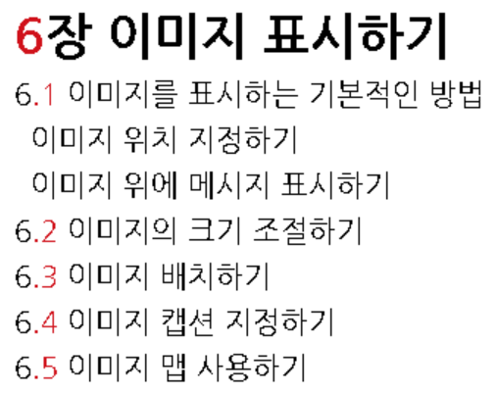
HTML

Slide 5
Java
13 Exception
13.1 Exception
13.1.1 Basic
13.1.2 Advance
13.2 Throw / Throws
13.2.1 Basic
13.2.2 Advance
13.3 Exam

Slide 6
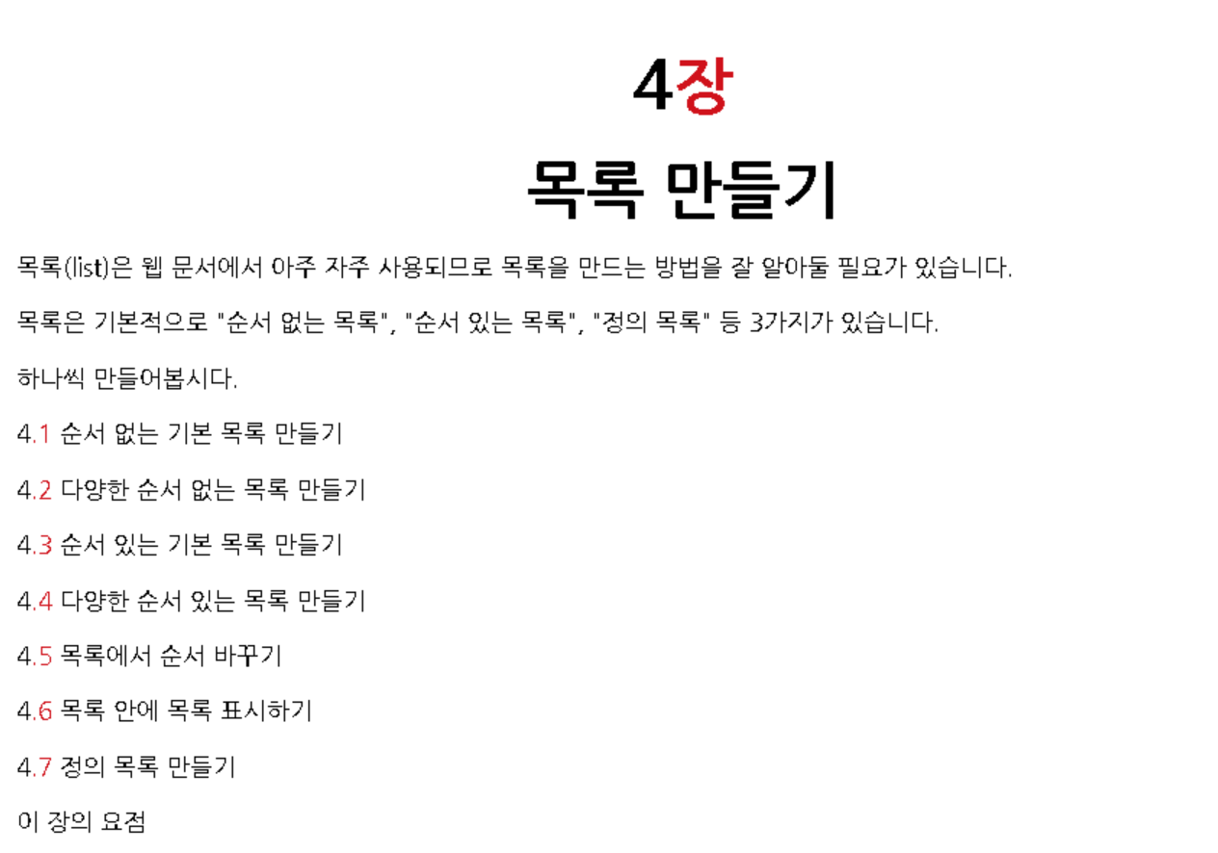

Slide 7
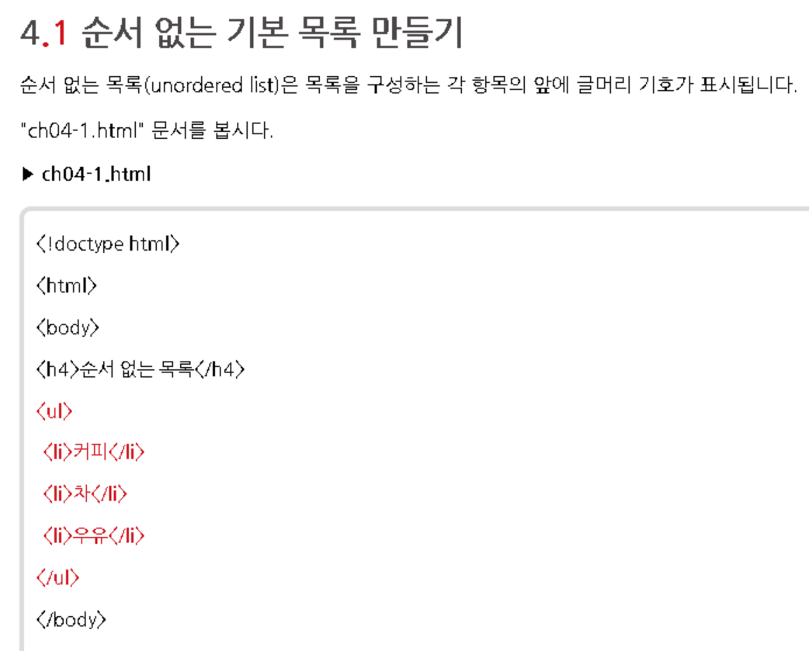
ul : unordered list
li : list item

Slide 8
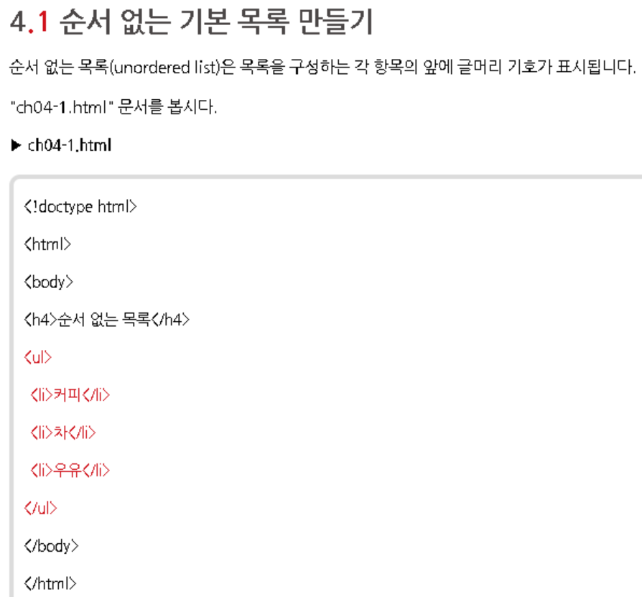
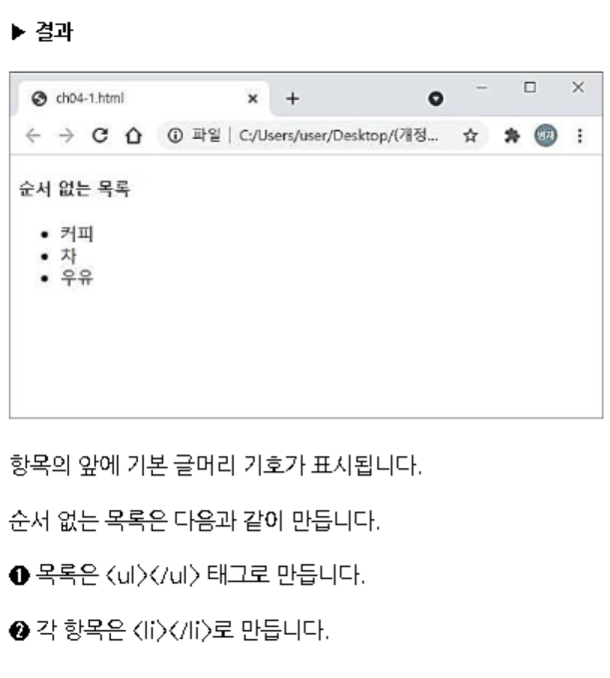

Slide 9
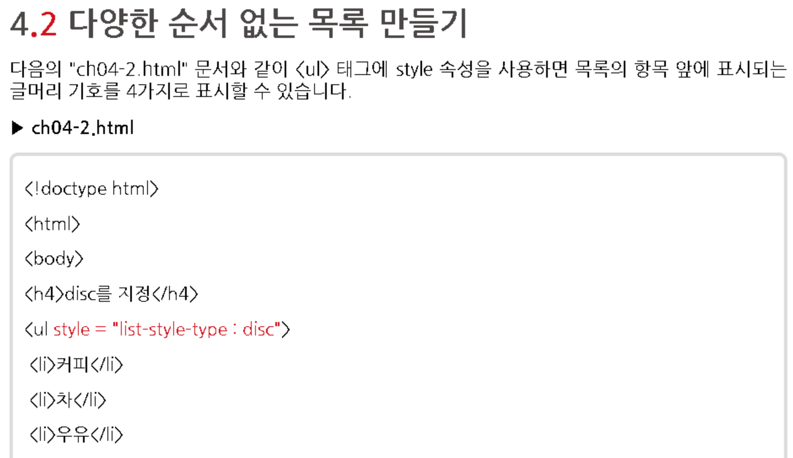
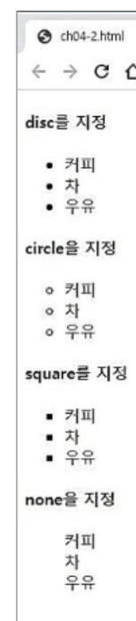
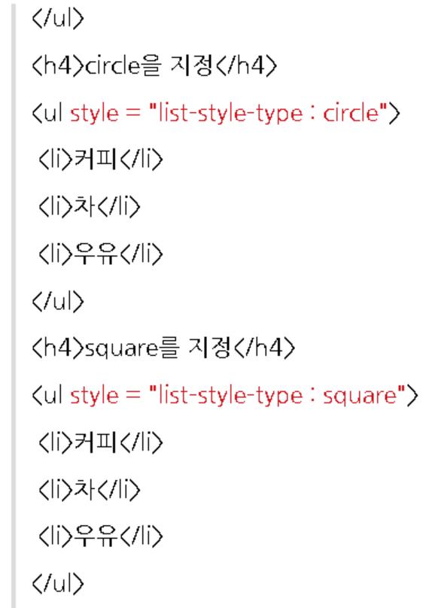
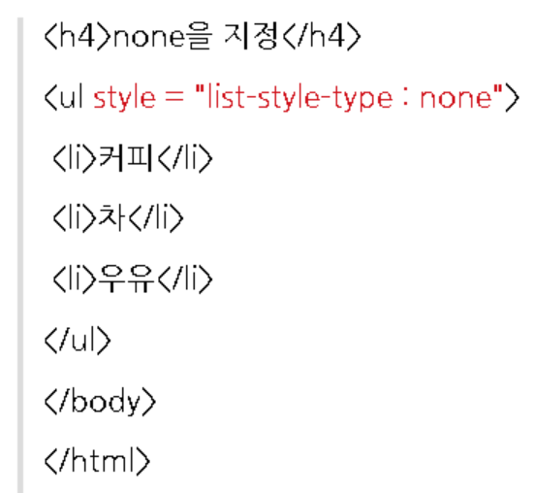

Slide 10
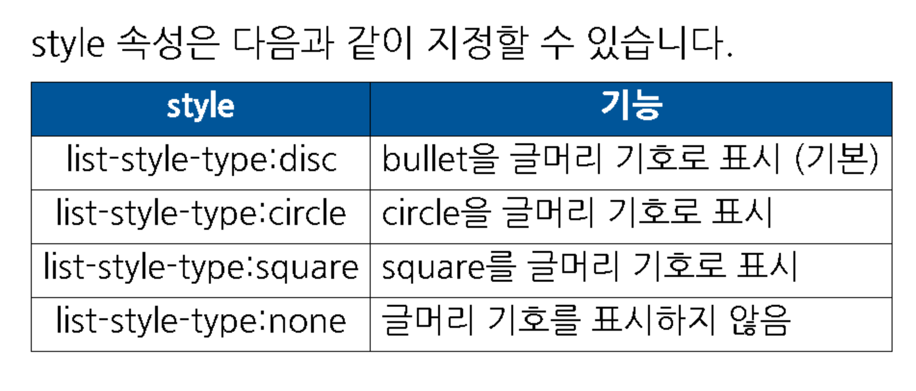

Slide 11
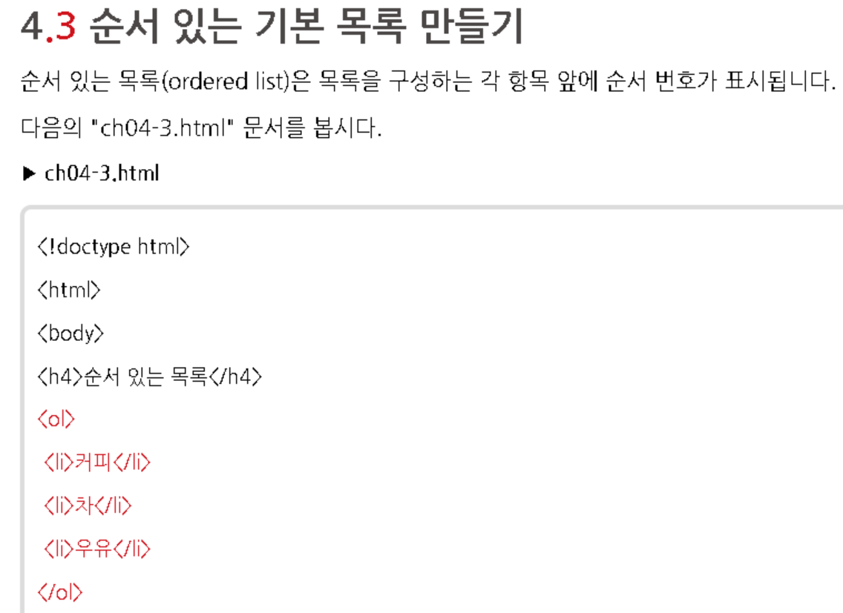
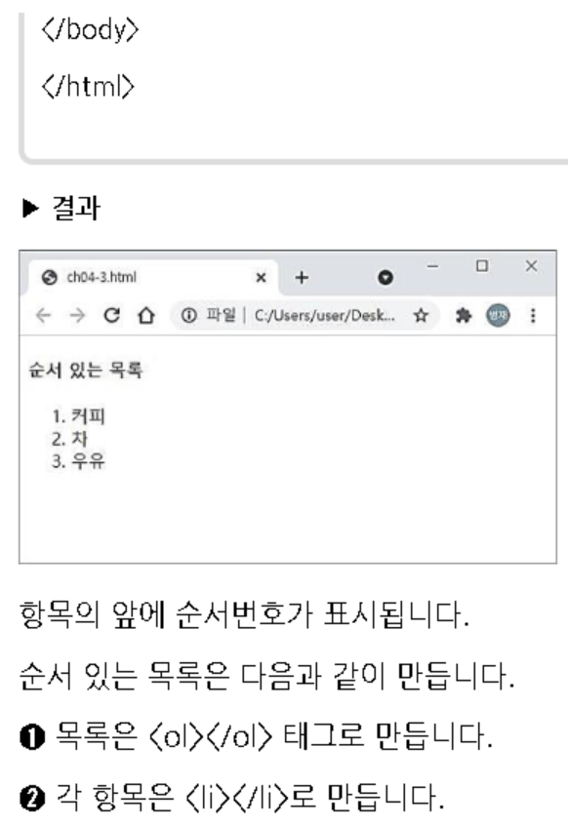

Slide 12
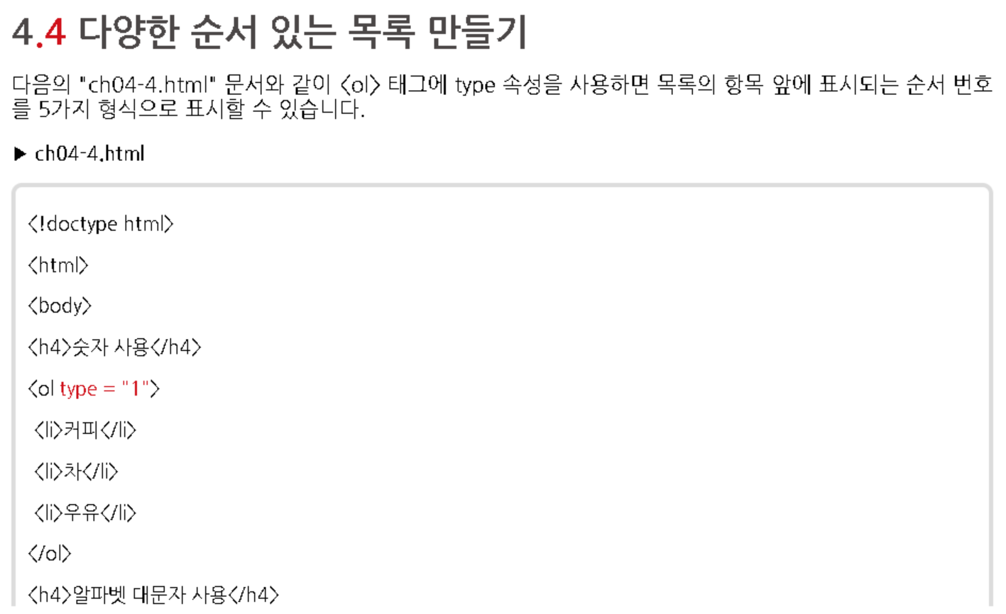
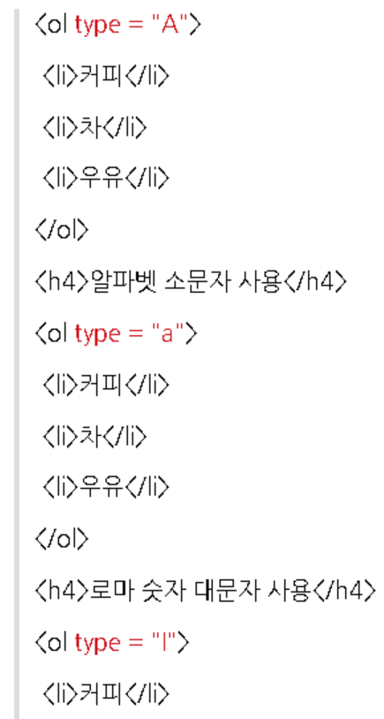
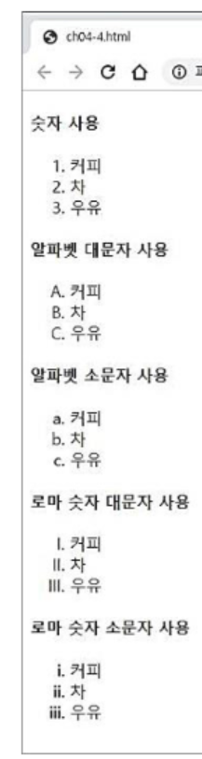
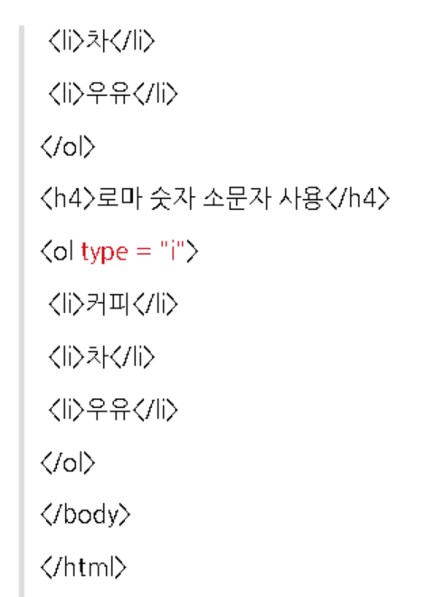

Slide 13
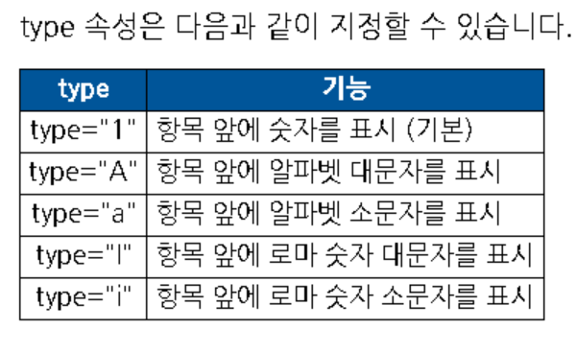

Slide 14
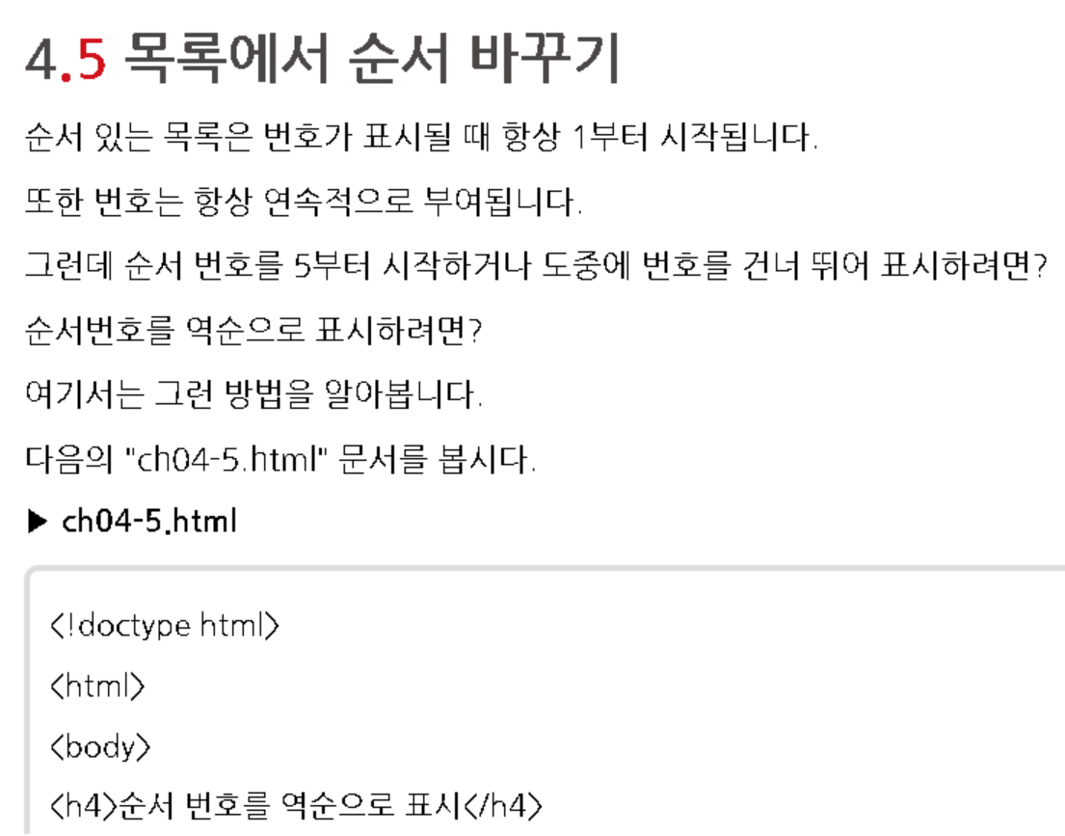
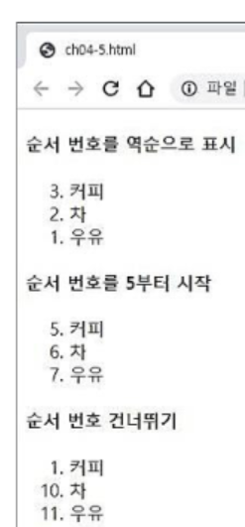
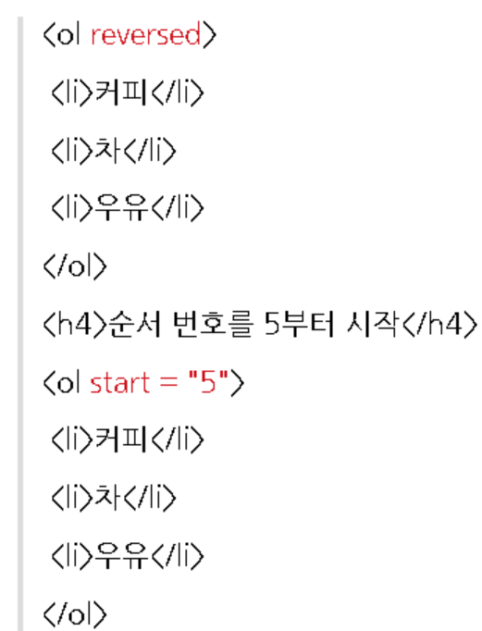
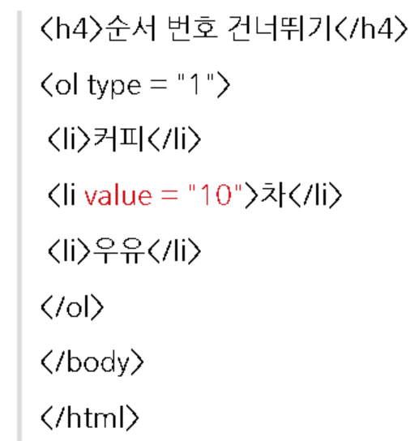
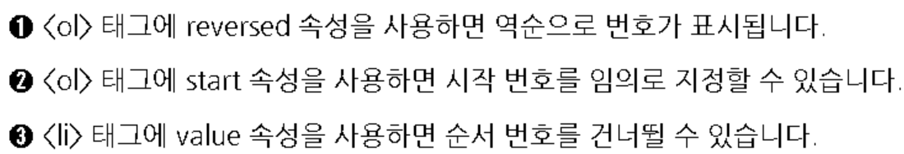

Slide 15
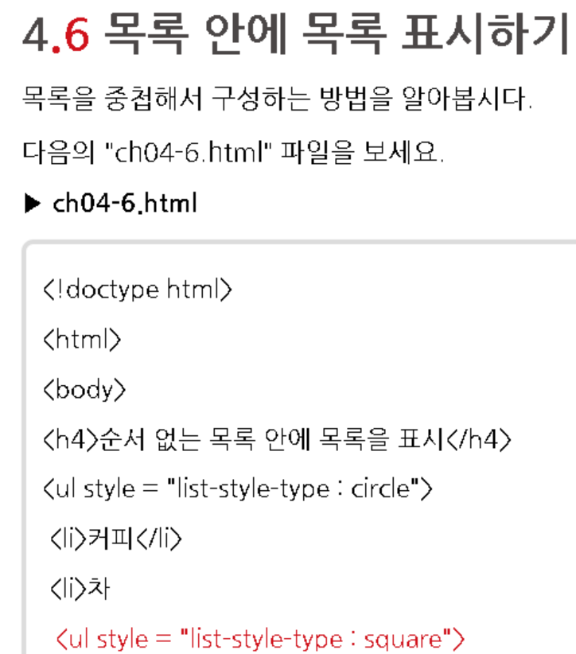
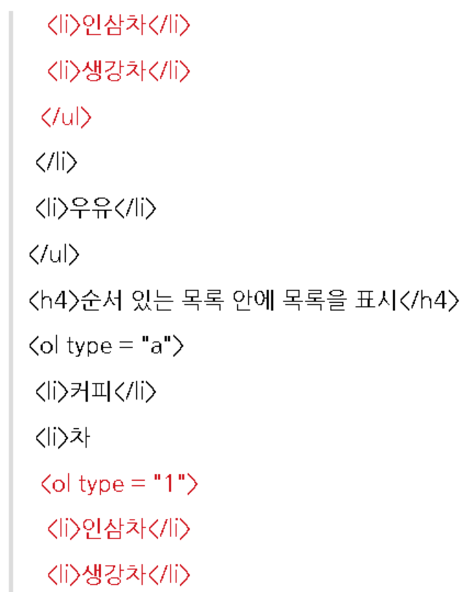
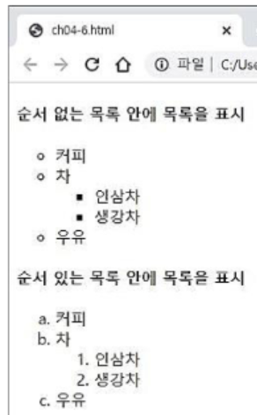
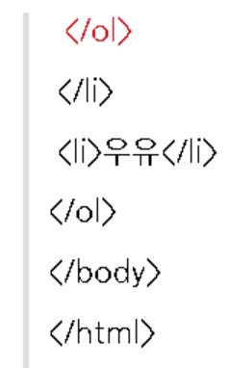

Slide 16
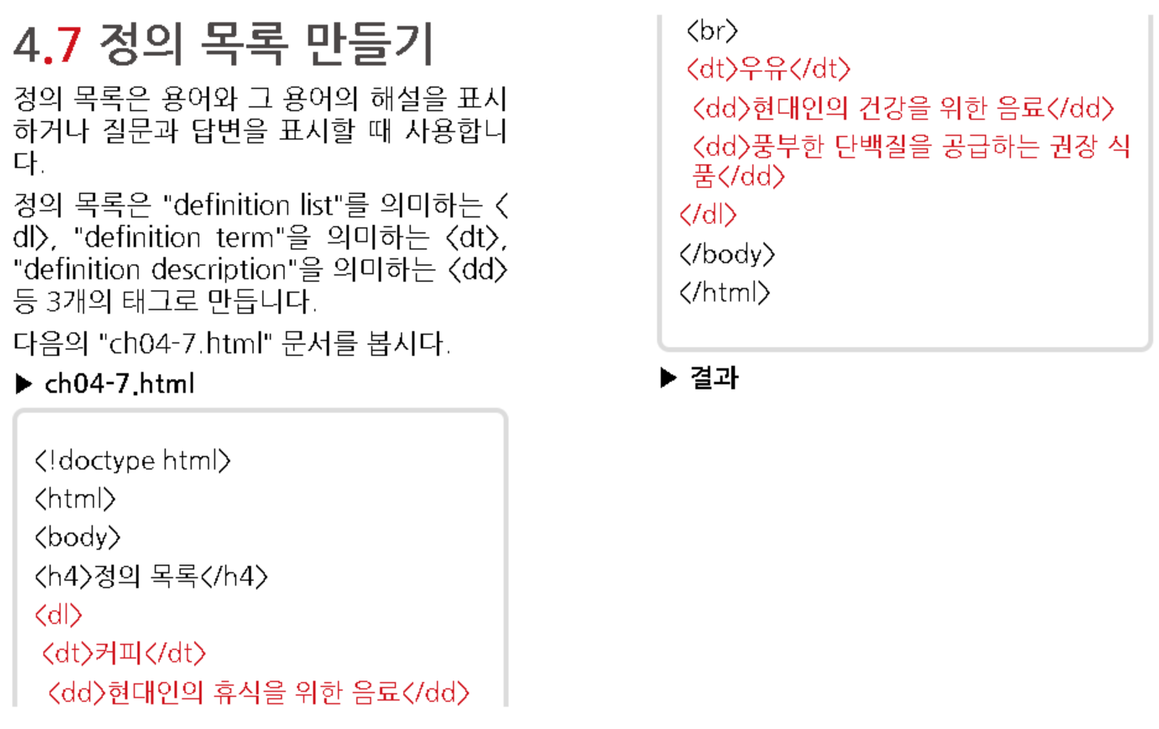
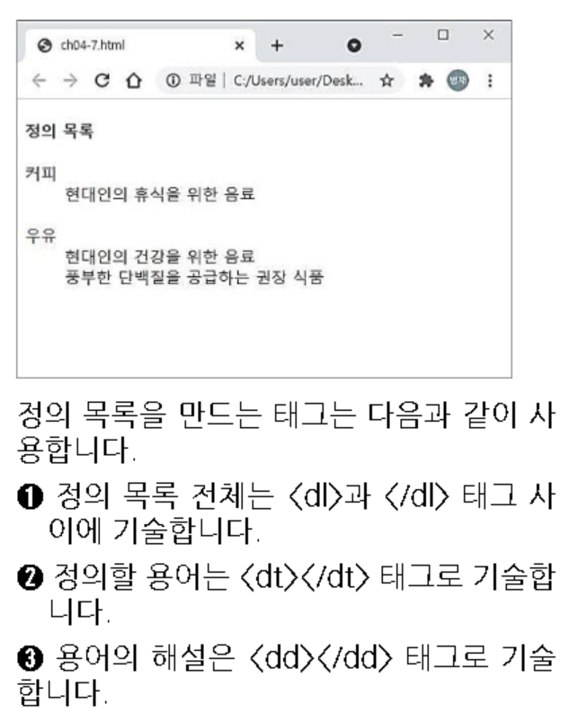

Slide 17
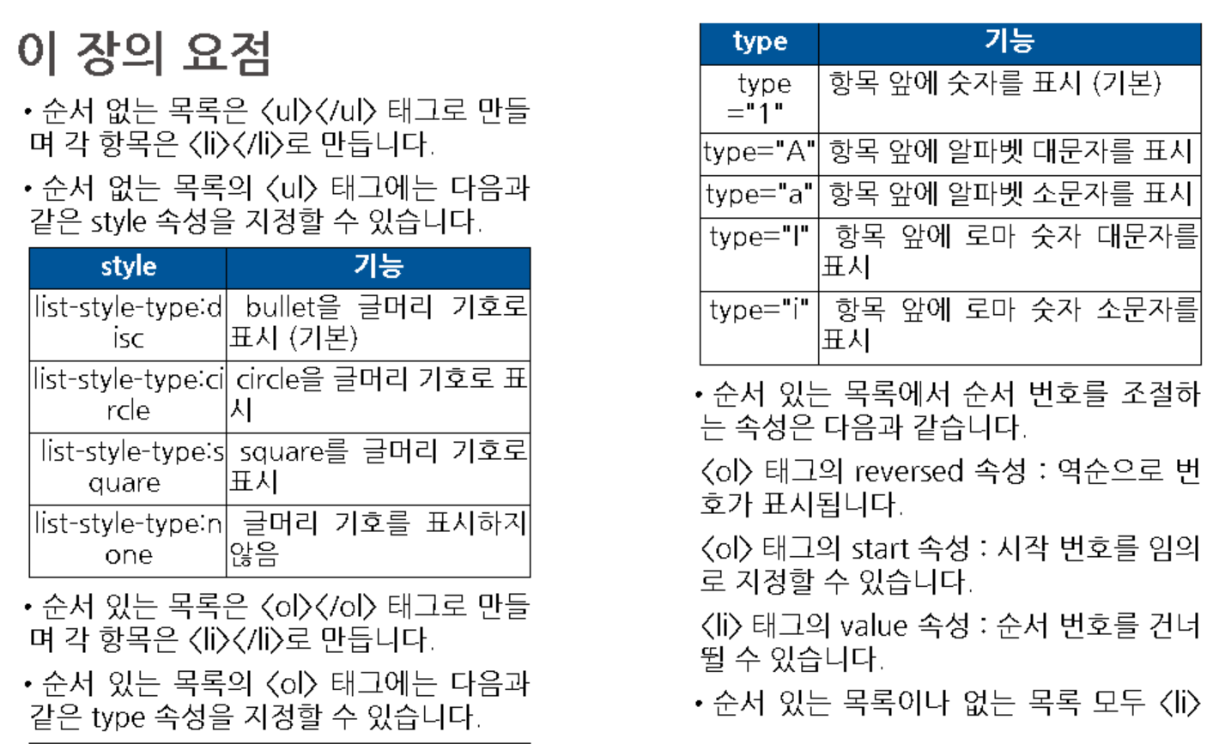
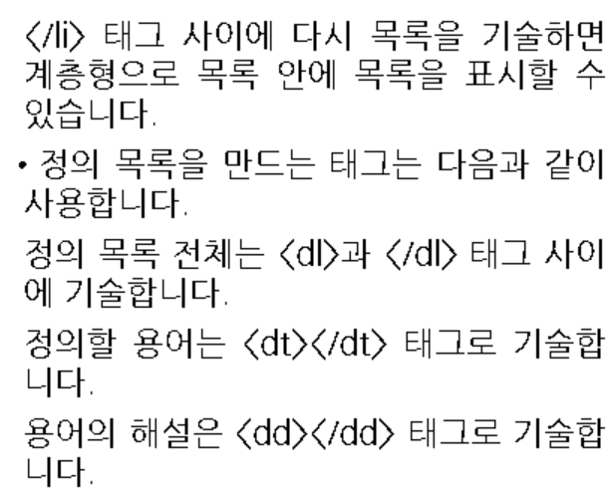

Slide 18
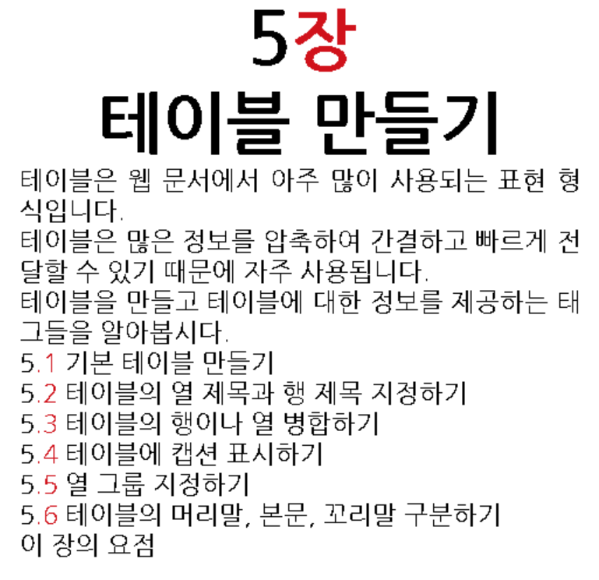

Slide 19
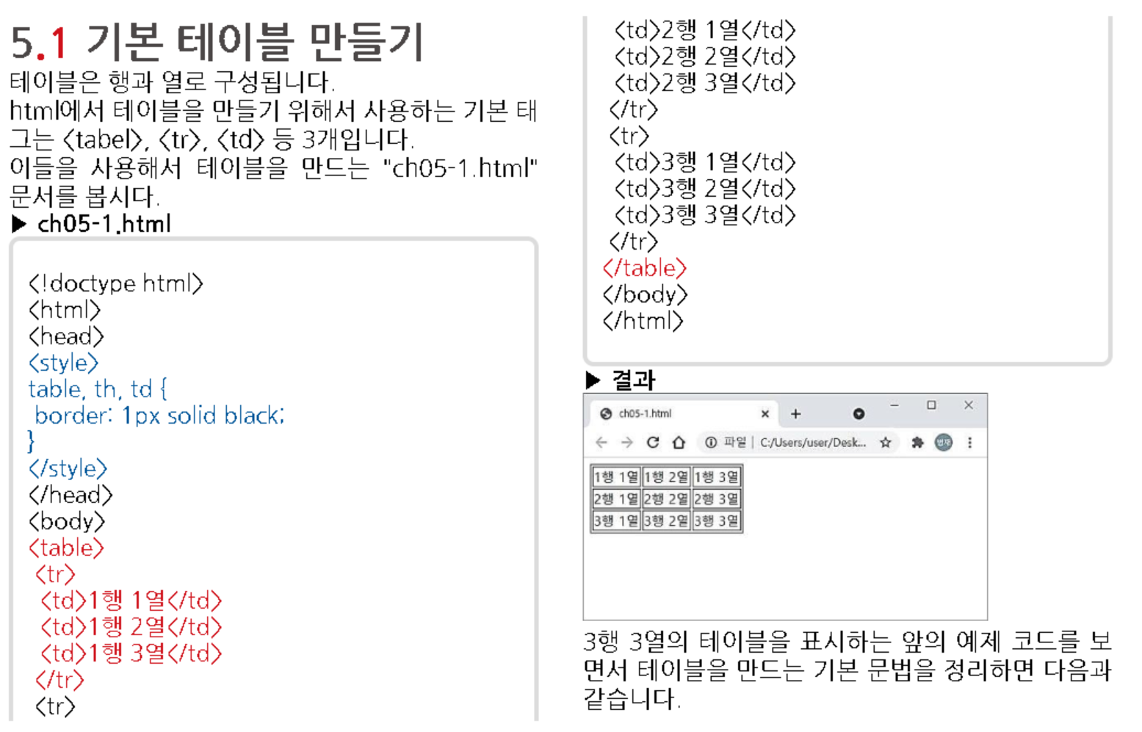

Slide 20
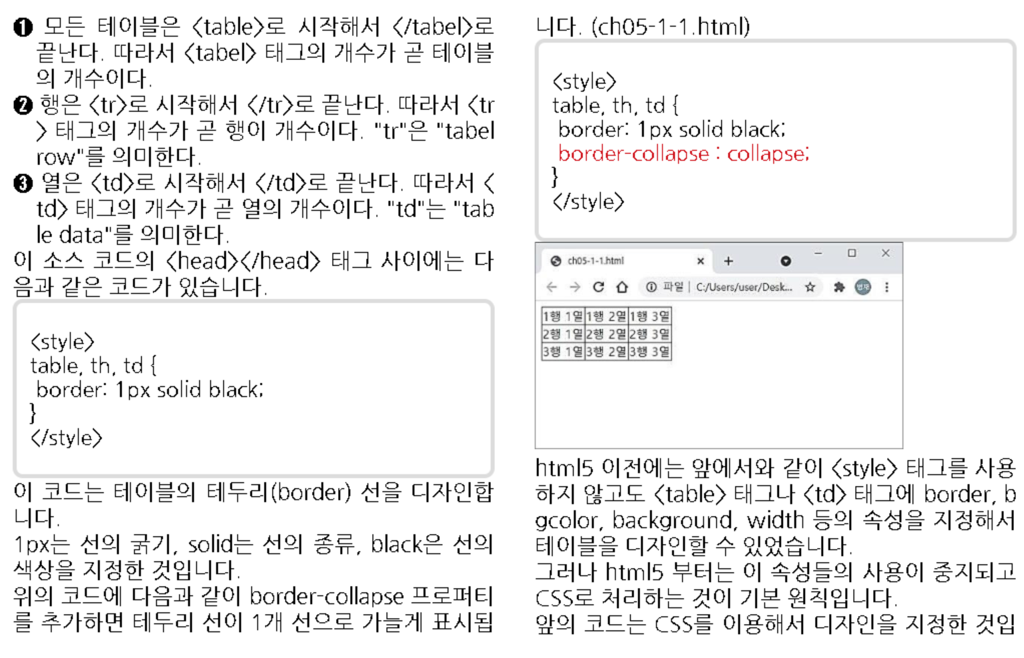
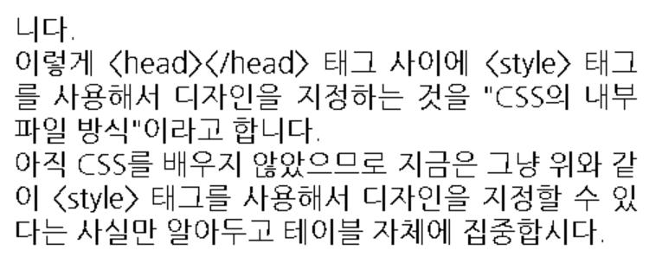

Slide 21
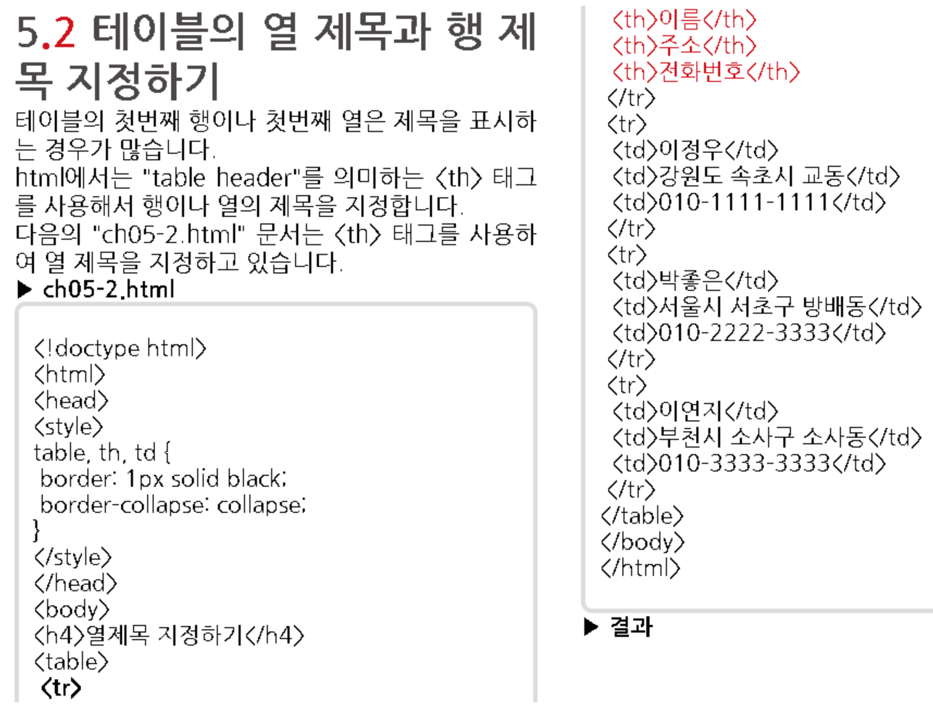
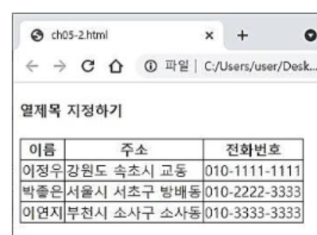

Slide 22
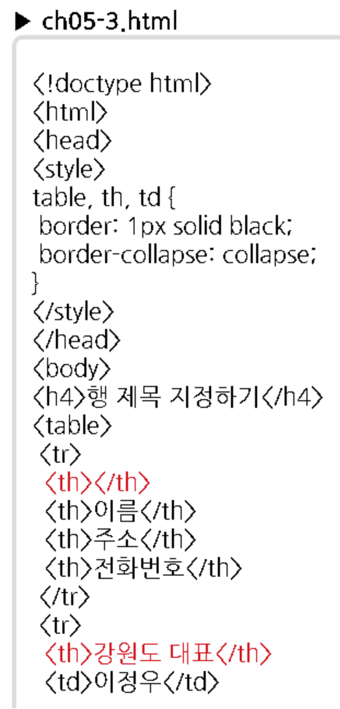
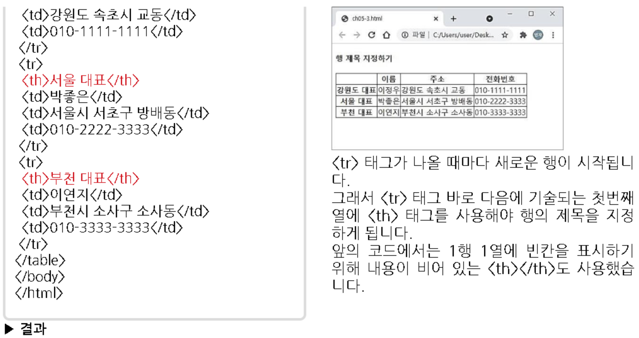

Slide 23
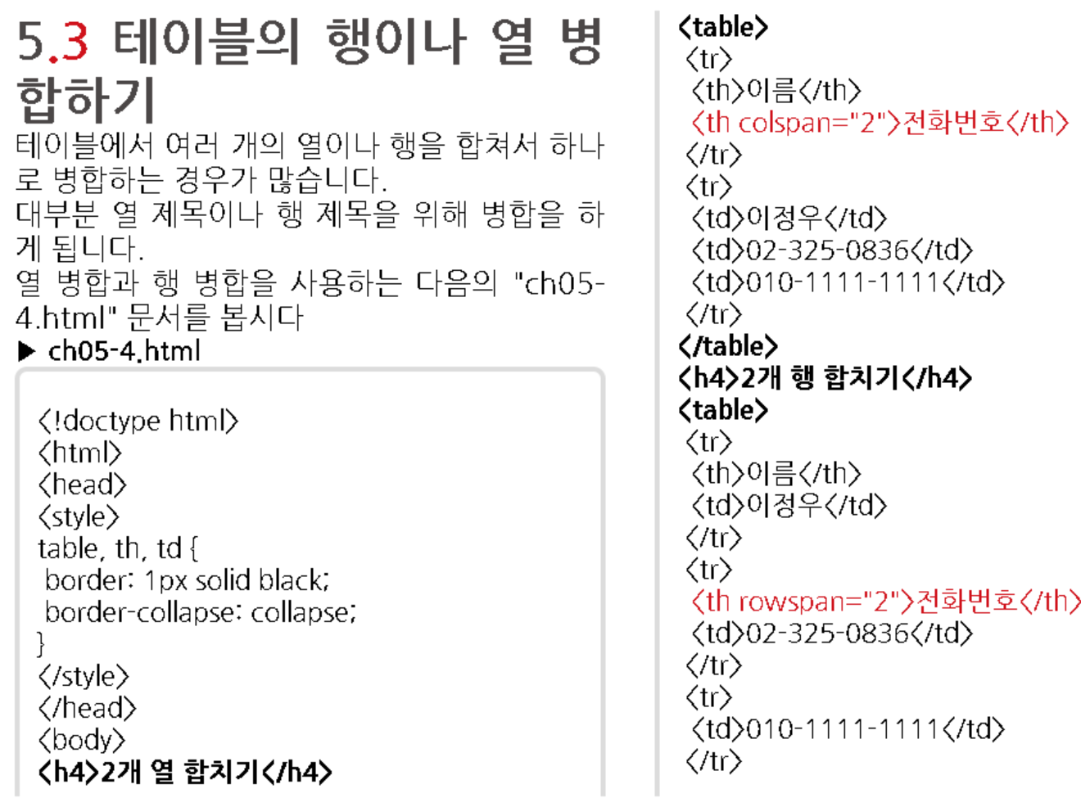
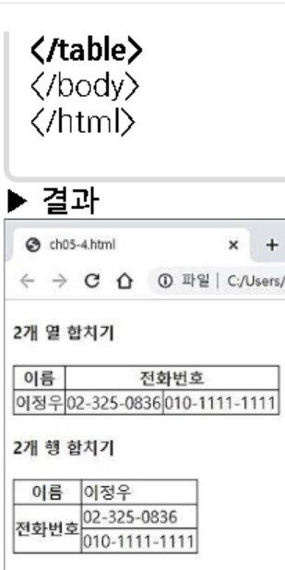

Slide 24
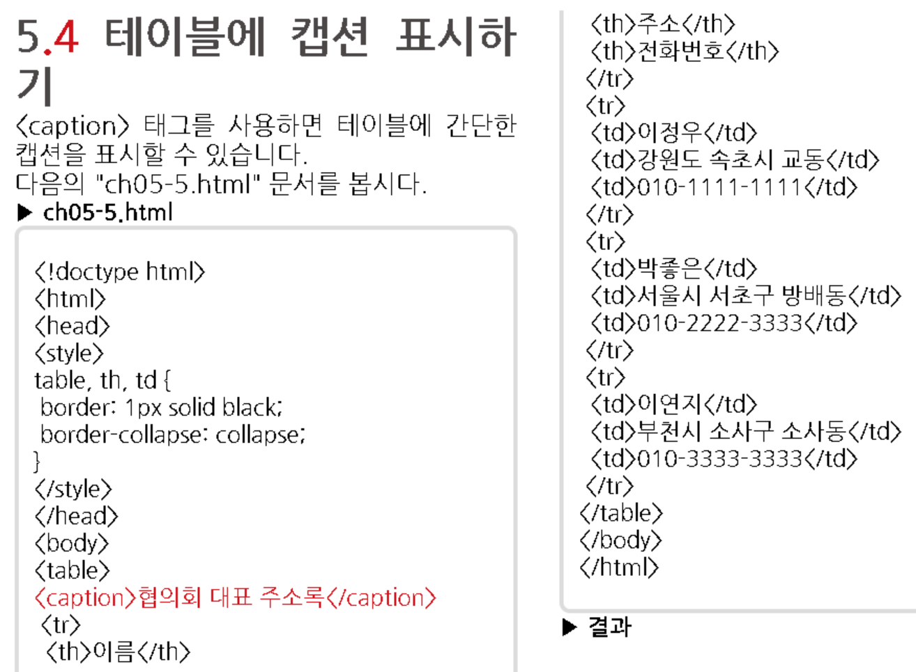
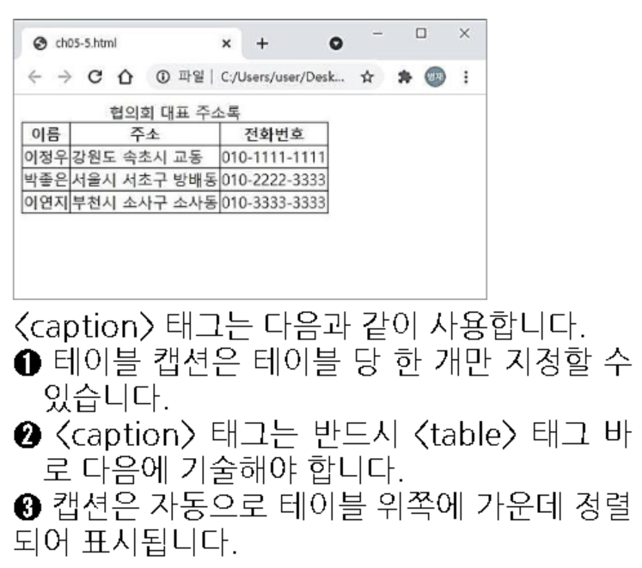

Slide 25
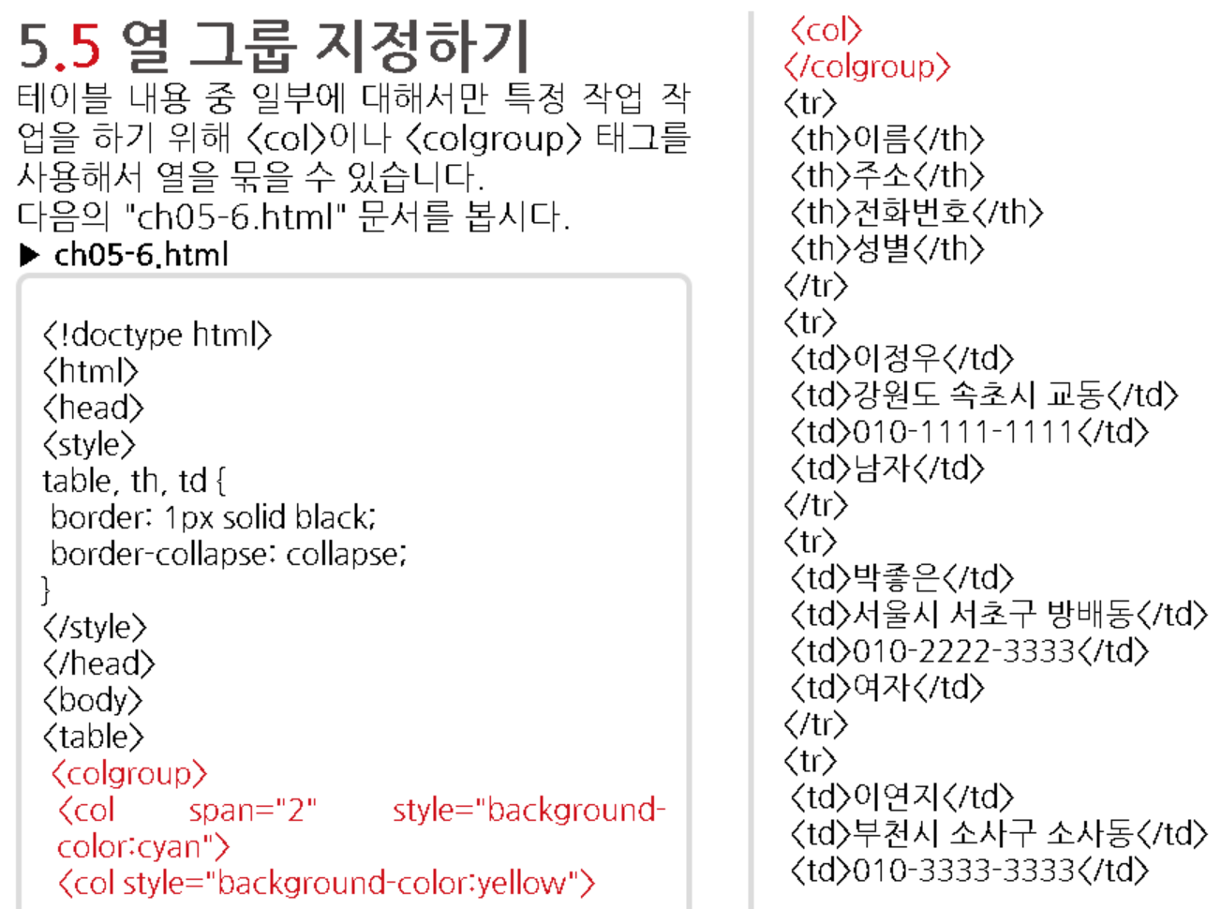
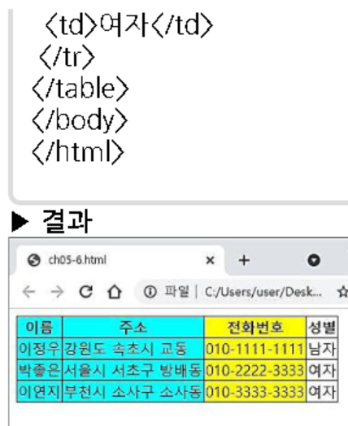

Slide 26
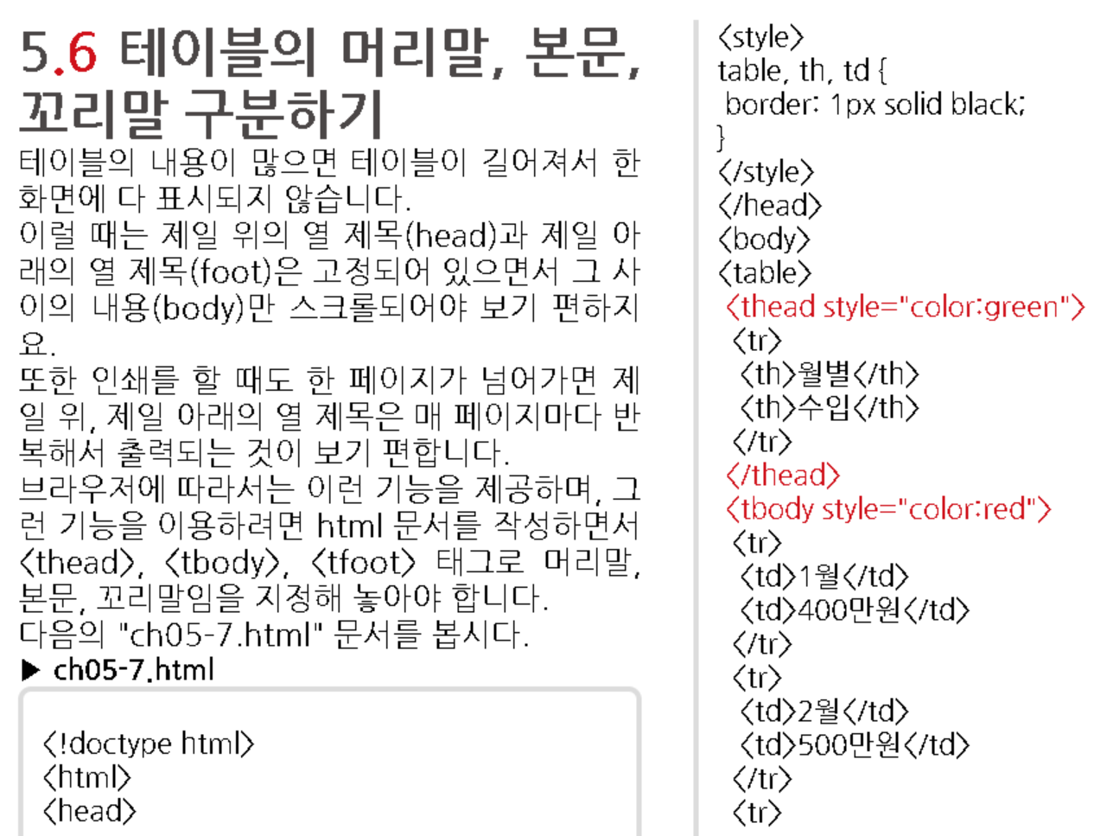
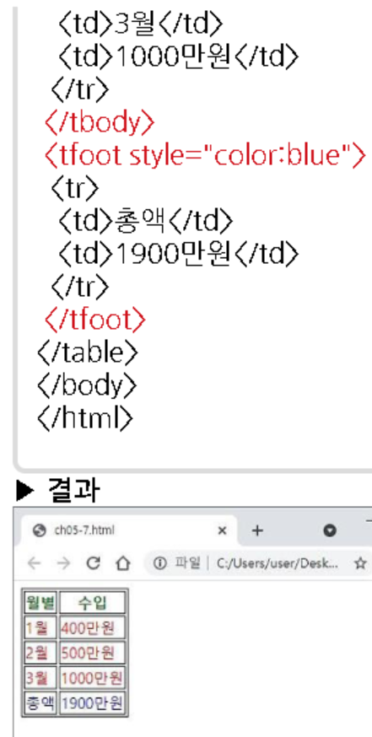

Slide 27
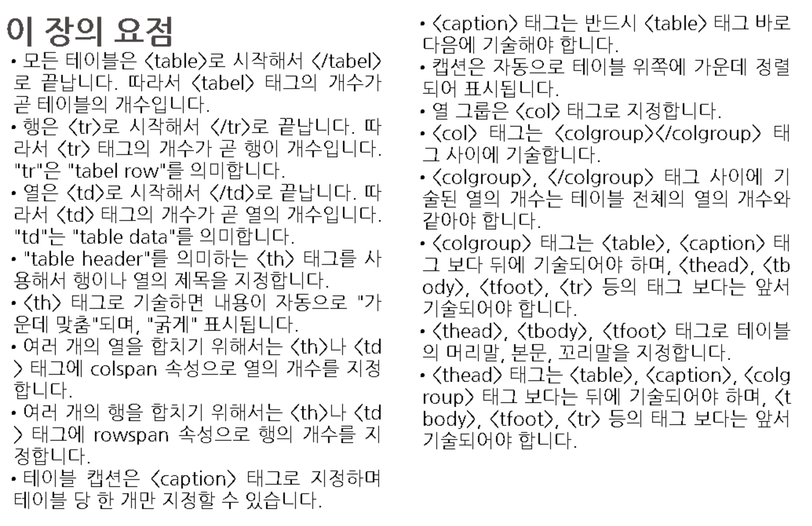

Slide 28
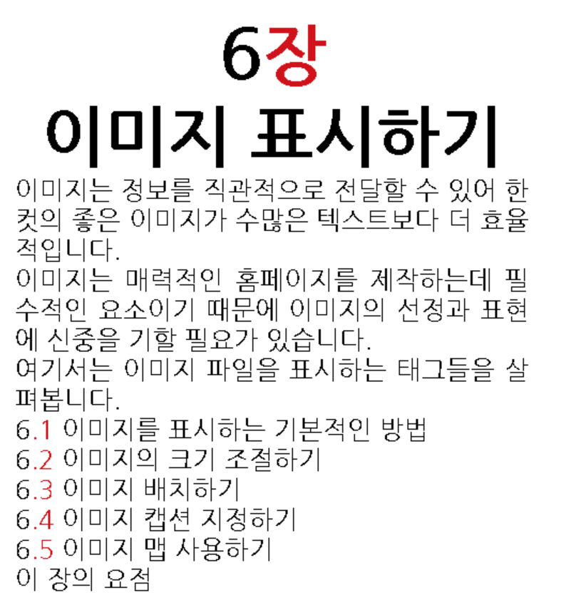

Slide 29


Slide 30



Slide 31


Slide 32



Slide 33



Slide 34


Slide 35



Slide 36


Slide 37





Slide 38


Slide 40


Slide 41


Slide 42


Slide 43


Slide 44


Slide 45


Slide 46


Slide 47



Slide 48


Slide 49


Slide 50


Slide 51


Slide 52


Slide 53


Slide 54


Slide 55



Slide 56


Slide 57


Slide 58


Slide 59


Slide 60


Slide 61


Slide 62


Slide 63


Slide 65



Slide 66
HTML
not yet…

Slide 67


